Slide 1
Production LLM Stealing
Huangzhao Zhang
zhang_hz@pku.edu.cn

Slide 2
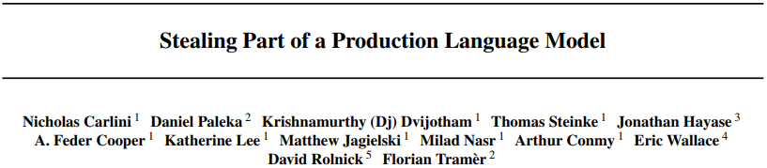


Slide 3
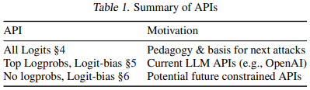
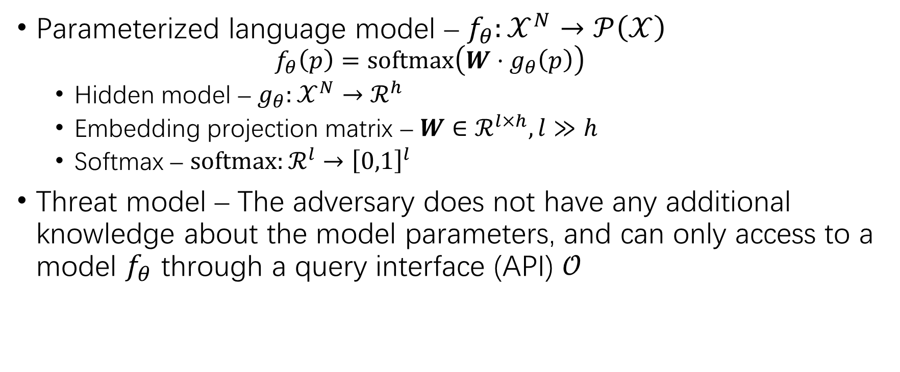
Problem Formulation
Parameterized language model – $f_{θ}:𝒳^{N}→𝒫\left(𝒳\right)$
$$f_{θ}\left(p\right)=softmax\left(W⋅g_{θ}\left(p\right)\right)$$
Hidden model – $g_{θ}:𝒳^{N}→ℛ^{h}$
Embedding projection matrix – $W∈ℛ^{l×h}, l≫h$
Softmax – $softmax:ℛ^{l}→{\left[0,1\right]}^{l}$
Threat model – The adversary does not have any additional knowledge about the model parameters, and can only access to a model $f_{θ}$ through a query interface (API) $𝒪$

Slide 4

Extraction Attack for Logit-Vector APIs
Logits API – $𝒪\left(p\right)←W⋅g_{θ}\left(p\right)$
Extract the hidden dimension $h$
Recover the matrix $W$

Slide 5
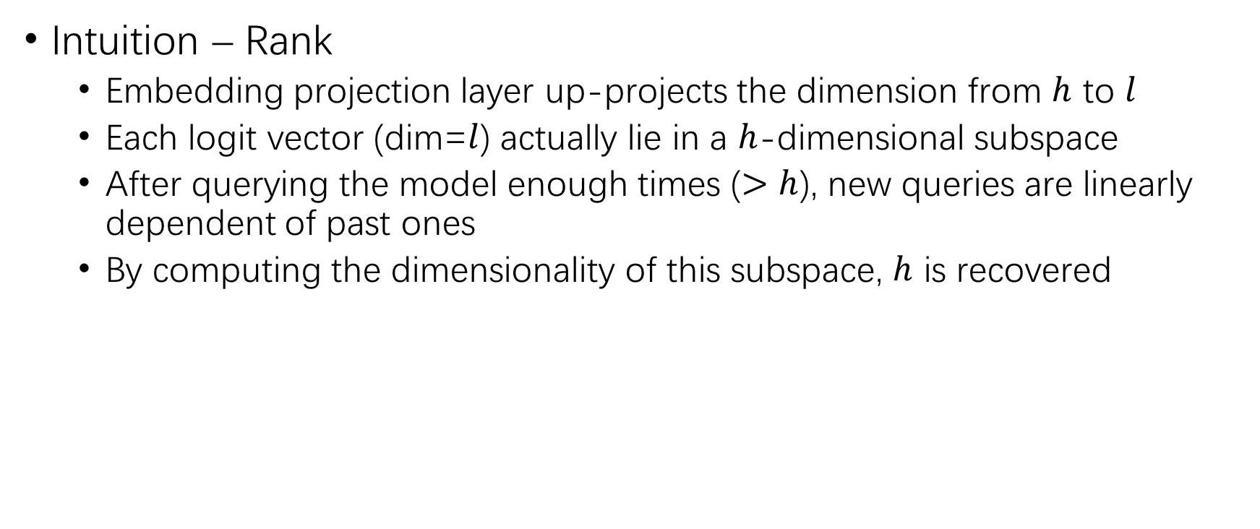
Recovering Hidden Dimensionality
Intuition – Rank
Embedding projection layer up-projects the dimension from $h$ to $l$
Each logit vector (dim=$l$) actually lie in a $h$-dimensional subspace
After querying the model enough times ($>h$), new queries are linearly dependent of past ones
By computing the dimensionality of this subspace, $h$ is recovered

Slide 6
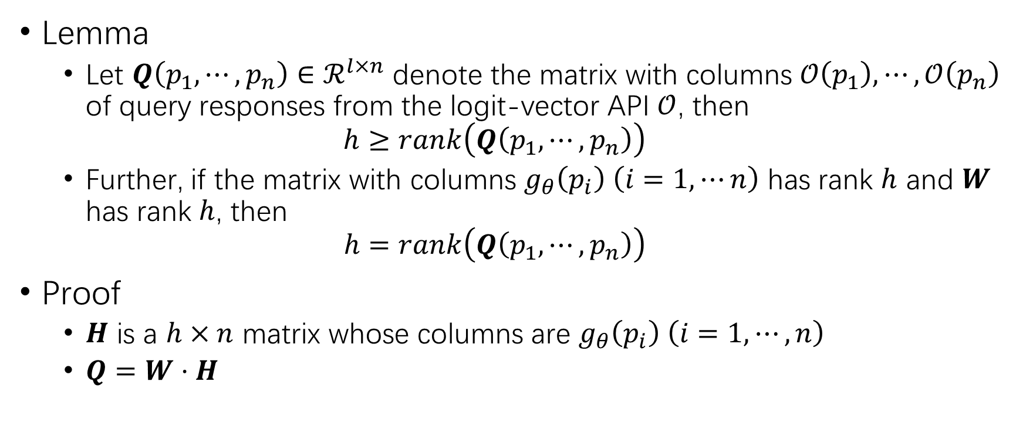
Recovering Hidden Dimensionality (2)
Lemma
Let $Q\left(p_{1},⋯,p_{n}\right)∈ℛ^{l×n}$ denote the matrix with columns $𝒪\left(p_{1}\right),⋯,𝒪\left(p_{n}\right)$ of query responses from the logit-vector API $𝒪$, then
$$h≥rank\left(Q\left(p_{1},⋯,p_{n}\right)\right)$$
Further, if the matrix with columns $g_{θ}\left(p_{i}\right) \left(i=1,⋯n\right)$ has rank $h$ and $W$ has rank $h$, then
$$h=rank\left(Q\left(p_{1},⋯,p_{n}\right)\right)$$
Proof
$H$ is a $h×n$ matrix whose columns are $g_{θ}\left(p_{i}\right) \left(i=1,⋯,n\right)$
$Q=W⋅H$

Slide 7
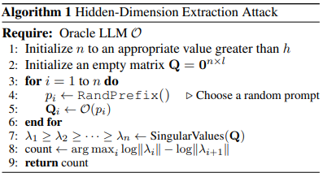
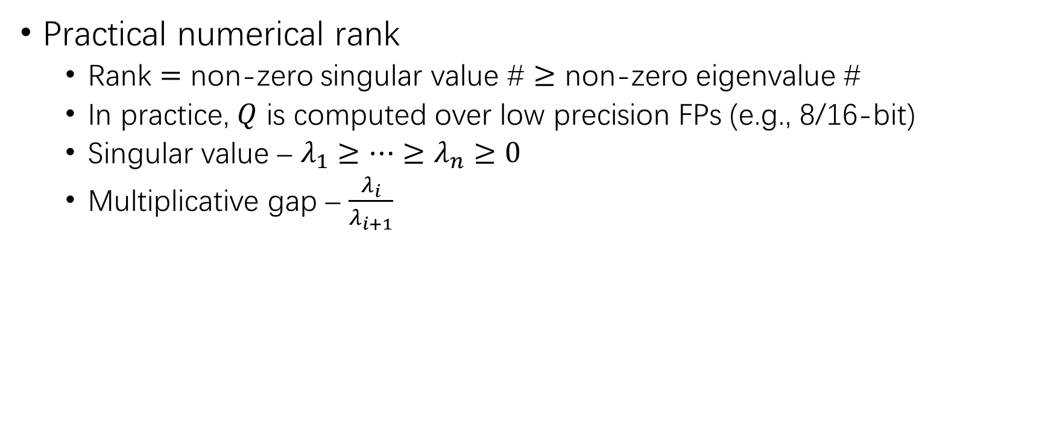
Recovering Hidden Dimensionality (3)
Practical numerical rank
Rank $=$ non-zero singular value # $≥$ non-zero eigenvalue #
In practice, $Q$ is computed over low precision FPs (e.g., 8/16-bit)
Singular value – $λ_{1}≥⋯≥λ_{n}≥0$
Multiplicative gap – $\frac{λ_{i}}{λ_{i+1}}$

Slide 8
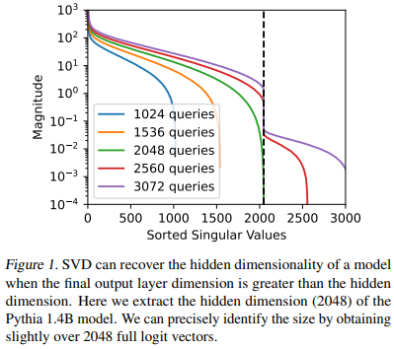
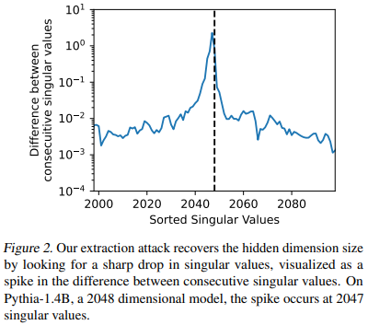
Recovering Hidden Dimensionality (4)

Slide 9

Full Layer Extraction
Method
$Q=W⋅H$
SVD – $Q=U⋅Σ⋅V^{T}$
$U$ directly represents $W$!
$U⋅Σ\text{ = }\text{W}⋅G$ for some $h×h$ matrix $G$

Slide 10
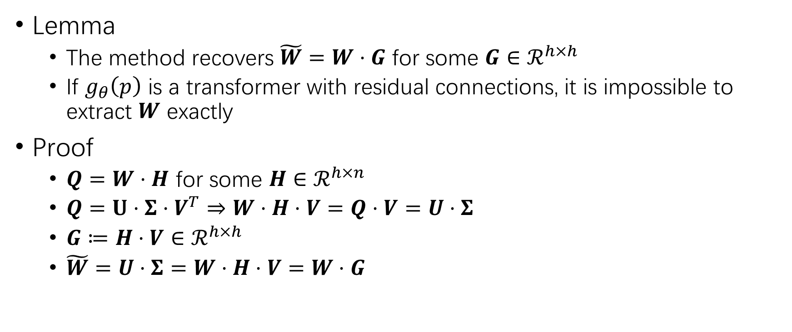
Full Layer Extraction (2)
Lemma
The method recovers $\tilde{W}=W⋅G$ for some $G∈ℛ^{h×h}$
If $g_{θ}\left(p\right)$ is a transformer with residual connections, it is impossible to extract $W$ exactly
Proof
$Q=W⋅H$ for some $H∈ℛ^{h×n}$
$Q=U⋅Σ⋅V^{T}⇒W⋅H⋅V=Q⋅V=U⋅Σ$
$G≔H⋅V∈ℛ^{h×h}$
$\tilde{W}=U⋅Σ=W⋅H⋅V=W⋅G$

Slide 11
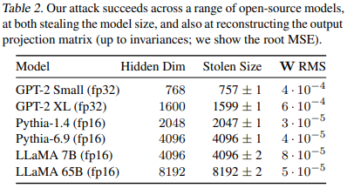
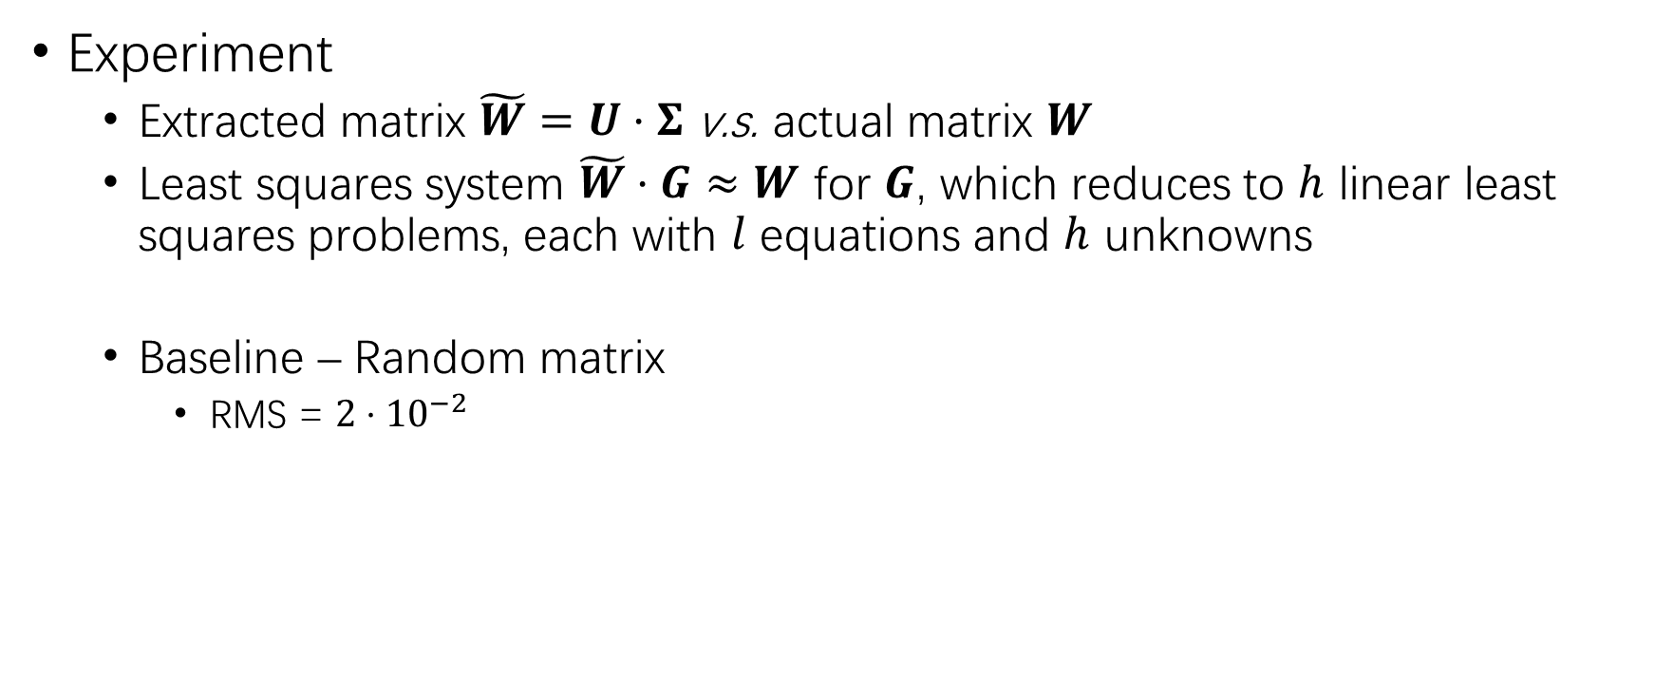
Full Layer Extraction (3)
Experiment
Extracted matrix $\tilde{W}=U⋅Σ$ v.s. actual matrix $W$
Least squares system $\tilde{W}⋅G≈W$ for $G$, which reduces to $h$ linear least squares problems, each with $l$ equations and $h$ unknowns
Baseline – Random matrix
RMS = $2⋅{10}^{−2}$

Slide 12

Extraction Attack for Logit Bias APIs
Logits-bias API
$$𝒪\left(p,b\right)←TopK\left(logsoftmax\left(Wg_{θ}\left(p\right)+b\right)\right)=TopK\left(Wg_{θ}\left(p\right)+b−\log\left(\sum_{i}{\exp{{\left(Wg_{θ}\left(p\right)+b\right)}_{i}}}\right)⋅1\right)$$
Bias – $b∈ℛ^{\left|𝒳\right|}$

Slide 13
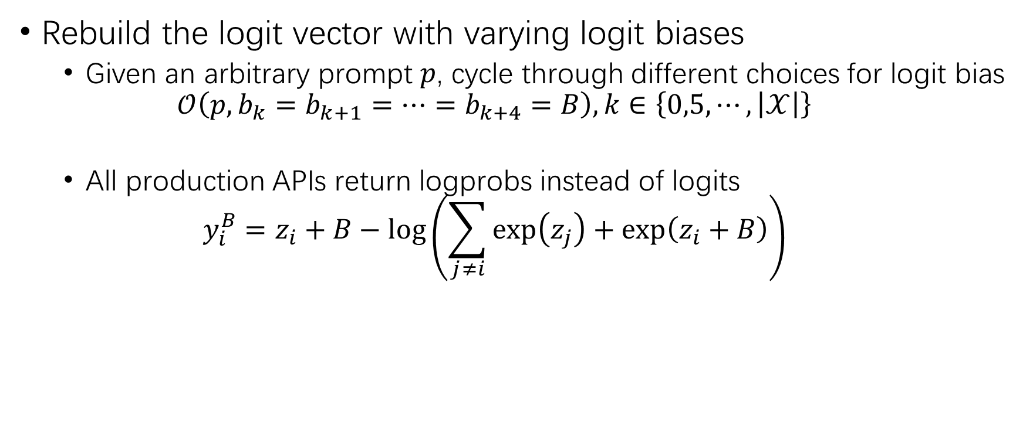
Extraction Attack for Top-5 Logit Bias APIs
Rebuild the logit vector with varying logit biases
Given an arbitrary prompt $p$, cycle through different choices for logit bias
$$𝒪\left(p,b_{k}=b_{k+1}=⋯=b_{k+4}=B\right), k∈\left\{0,5,⋯,\left|𝒳\right|\right\}$$
All production APIs return logprobs instead of logits
$$y_{i}^{B}=z_{i}+B−\log\left(\sum_{j≠i}{\exp\left(z_{j}\right)+\exp\left(z_{i}+B\right)}\right)$$
Bias dependent

Slide 14

Extraction Attack for Top-5 Logit Bias APIs (2)
“Reference” token – Align with the top token $R$
$$y_{R}^{B}−y_{i}^{B}−B=z_{R}+z_{i}$$
Given a prompt $p$, push four tokens along with $R$ into the top-5
$$𝒪\left(p,b_{i}=b_{i+1}=b_{i+2}=b_{i+3}=B\right), k∈\left\{0,4,8,⋯,\left|𝒳\right|\right\}$$

Slide 15
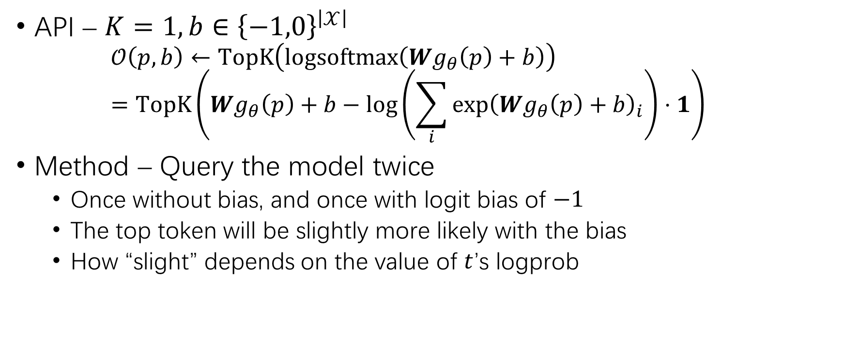
Extraction Attack for Top-1 Binary Logit Bias APIs
API – $K=1, b∈{\left\{−1,0\right\}}^{\left|𝒳\right|}$
$$𝒪\left(p,b\right)←TopK\left(logsoftmax\left(Wg_{θ}\left(p\right)+b\right)\right)=TopK\left(Wg_{θ}\left(p\right)+b−\log\left(\sum_{i}{\exp{{\left(Wg_{θ}\left(p\right)+b\right)}_{i}}}\right)⋅1\right)$$
Method – Query the model twice
Once without bias, and once with logit bias of $−1$
The top token will be slightly more likely with the bias
How “slight” depends on the value of $t$’s logprob

Slide 16

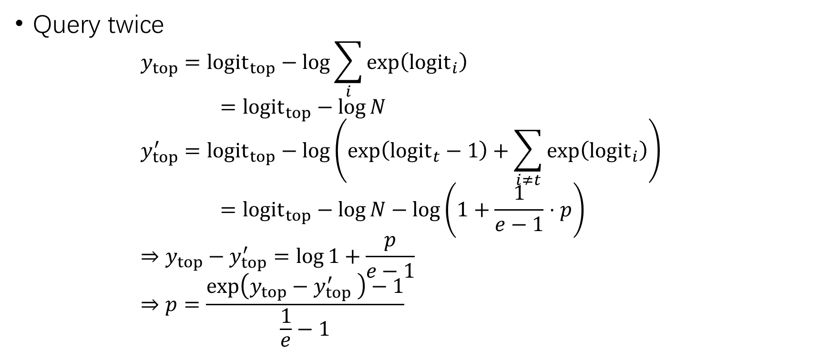
Extraction Attack for Top-1 Binary Logit Bias APIs (2)
$$N=\sum_{i}{\exp\left({logit}_{i}\right)} \\ p=\frac{\exp\left({logit}_{t}\right)}{N}$$
Query twice
$$y_{top}=logit_{top}−\log{\sum_{i}{\exp\left({logit}_{i}\right)}} \\ =logit_{top}−\log{N} \\ y_{top}^{′}=logit_{top}−\log\left(\exp\left({logit}_{t}−1\right)+\sum_{i≠t}{\exp\left({logit}_{i}\right)}\right) \\ =logit_{top}−\log{N}−\log\left(1+\frac{1}{e−1}⋅p\right) \\ ⇒y_{top}−y_{top}^{′}=\log{1+\frac{p}{e−1}} \\ ⇒p=\frac{\exp\left(y_{top}−y_{top}^{′} \right)−1}{\frac{1}{e}−1}$$

Slide 17

Extraction From Logprob-free APIs
API
$$𝒪\left(p,b\right)←ArgMax\left(logsoftmax\left(Wg_{θ}\left(p\right)+b\right)\right)$$
Reconstruct the logit vector up to an additive error of $ε$ ($∞$-norm)

Slide 18
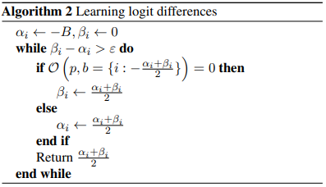
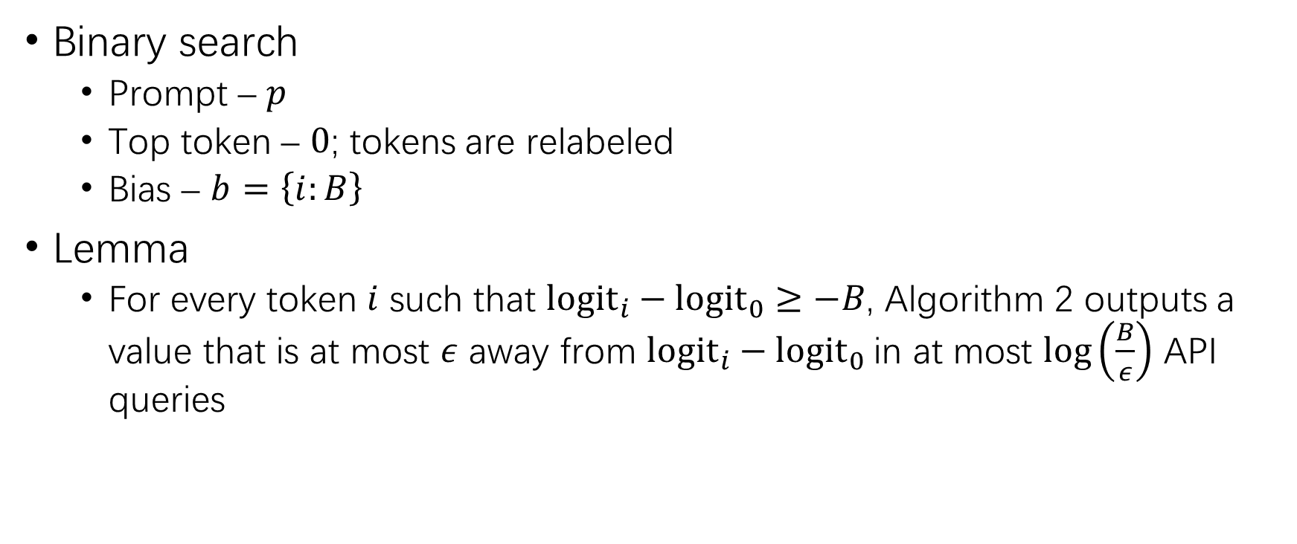
Basic Logprob-free Attack
Binary search
Prompt – $p$
Top token – $0$; tokens are relabeled
Bias – $b=\left\{i:B\right\}$
Lemma
For every token $i$ such that ${logit}_{i}−{logit}_{0}≥−B$, Algorithm 2 outputs a value that is at most $ε$ away from ${logit}_{i}−{logit}_{0}$in at most $\log\left(\frac{B}{ε}\right)$ API queries

Slide 19
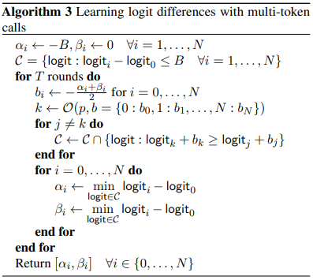
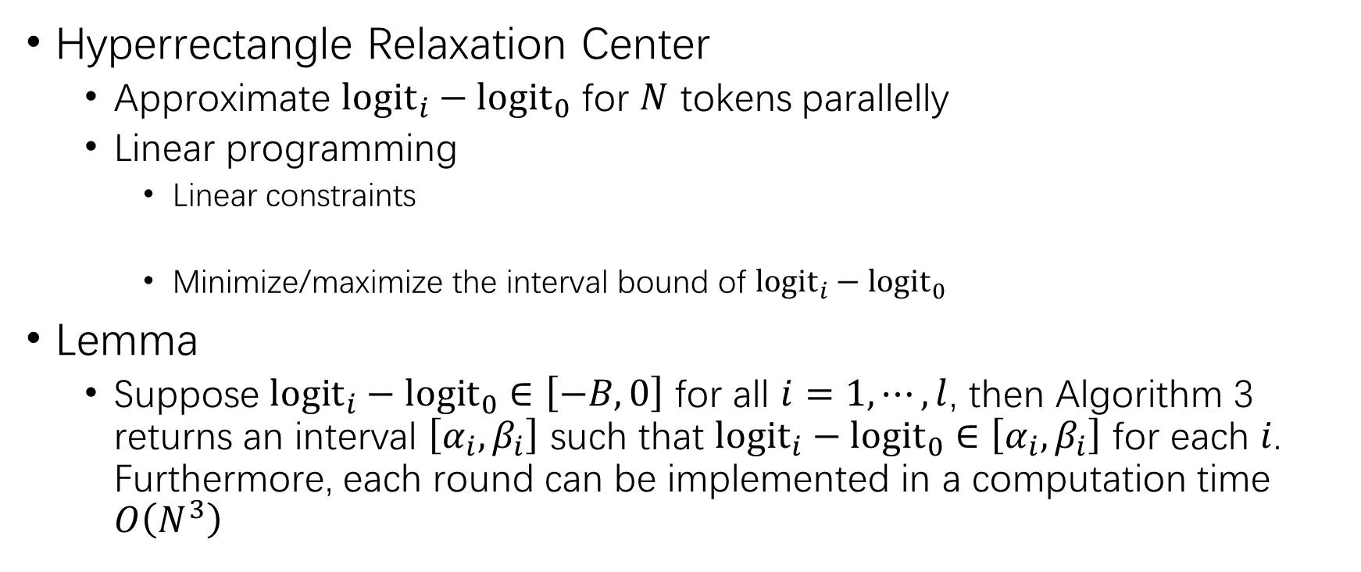
Basic Logprob-free Attack (2)
Hyperrectangle Relaxation Center
Approximate ${logit}_{i}−{logit}_{0}$ for $N$ tokens parallelly
Linear programming
Linear constraints
Minimize/maximize the interval bound of ${logit}_{i}−{logit}_{0}$
Lemma
Suppose ${logit}_{i}−{logit}_{0}∈\left[−B,0\right]$ for all $i=1,⋯,l$, then Algorithm 3 returns an interval $\left[α_{i},β_{i}\right]$ such that ${logit}_{i}−{logit}_{0}∈\left[α_{i},β_{i}\right]$ for each $i$. Furthermore, each round can be implemented in a computation time $O\left(N^{3}\right)$
$$k=𝒪\left(p,b={\left\{i:b_{i}\right\}}_{i=1}^{l}\right)⇒{logit}_{k}+b_{k}≥{logit}_{j}+b_{j},∀j≠k$$

Slide 20
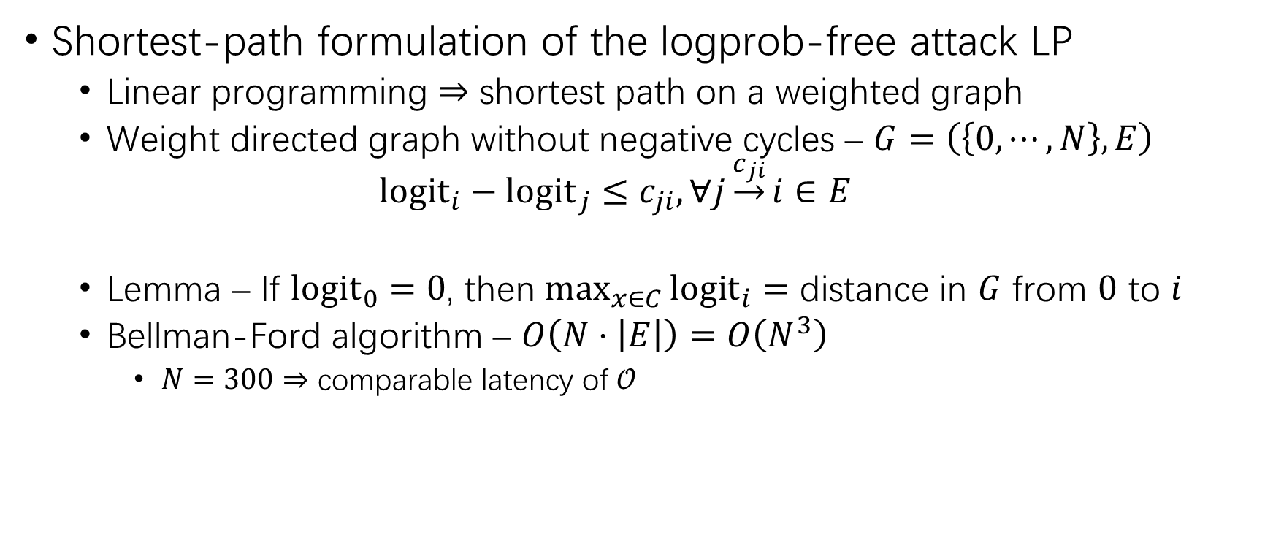
Basic Logprob-free Attack (3)
Shortest-path formulation of the logprob-free attack LP
Linear programming $⇒$ shortest path on a weighted graph
Weight directed graph without negative cycles – $G=\left(\left\{0,⋯,N\right\},E\right)$
$${logit}_{i}−{logit}_{j}≤c_{ji},∀j\underset{→}{c_{ji}}i∈E$$
Lemma – If ${logit}_{0}=0$, then $\max_{x∈C}{{logit}_{i}=}$ distance in $G$ from $0$ to $i$
Bellman-Ford algorithm – $O\left(N⋅\left|E\right|\right)=O\left(N^{3}\right)$
$N=300⇒$ comparable latency of $𝒪$

Slide 21
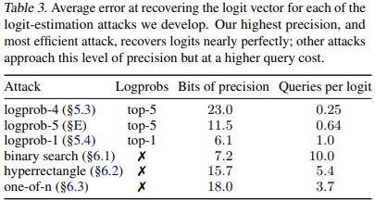
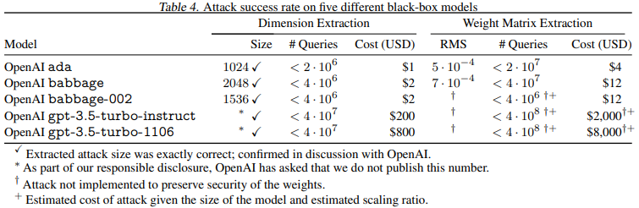
Evaluation

Slide 22
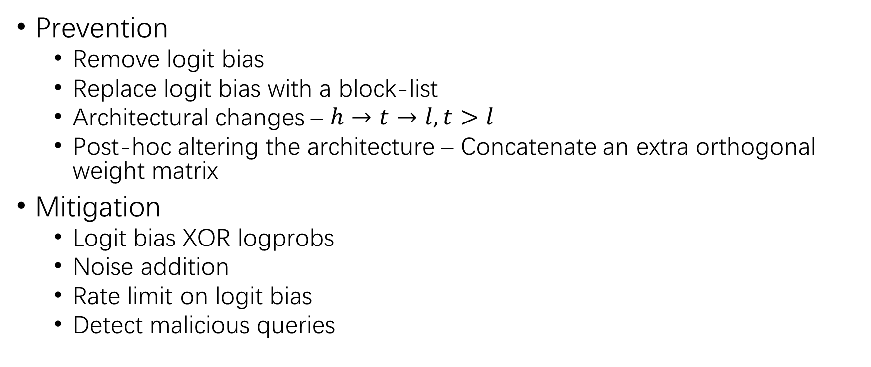
Defense
Prevention
Remove logit bias
Replace logit bias with a block-list
Architectural changes – $h→t→l, t>l$
Post-hoc altering the architecture – Concatenate an extra orthogonal weight matrix
Mitigation
Logit bias XOR logprobs
Noise addition
Rate limit on logit bias
Detect malicious queries

Slide 23
THANK YOU!

